Slide 1
Software Evolution
Static Code Analysis

Slide 2
Static Code Analysis
A method of debugging by examining source code before a program is run. It’s done by analyzing a set of code against a set (or multiple sets) of coding rules.

Slide 3
Motivation
Code Knowledge. Collect more information about the source code itself to help in refactoring and bugs trouble-shooting
Continuous feedback to developers to adhere to the best practices while developing

Slide 4
Use Cases
Continuous analyzing for the code and give recommendations to the developer to adhere to the coding standards
Automated way to assess the quality of the software modules (i.e. Classes)

Slide 5
Tools
SonarQuobe
Codacy

Slide 6
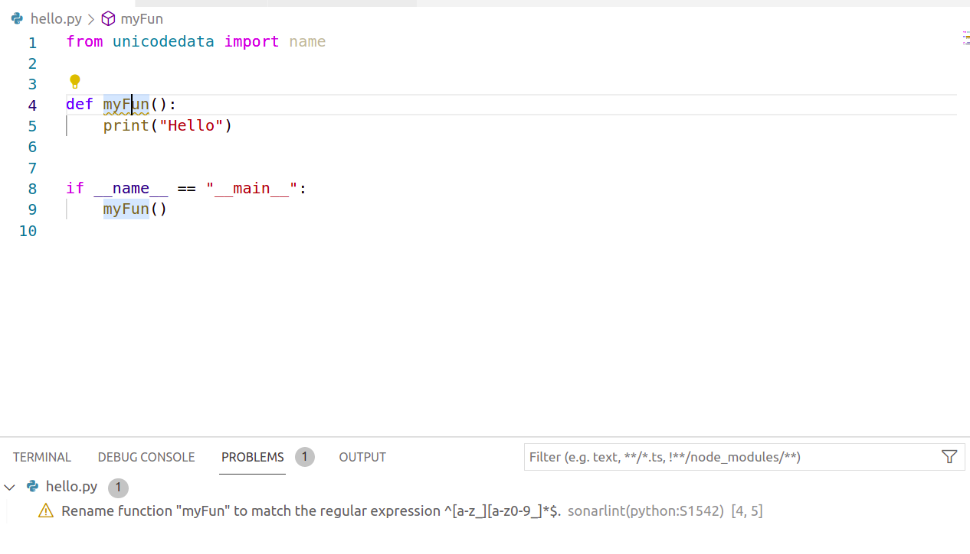
Examples (Recommendations)

Slide 7
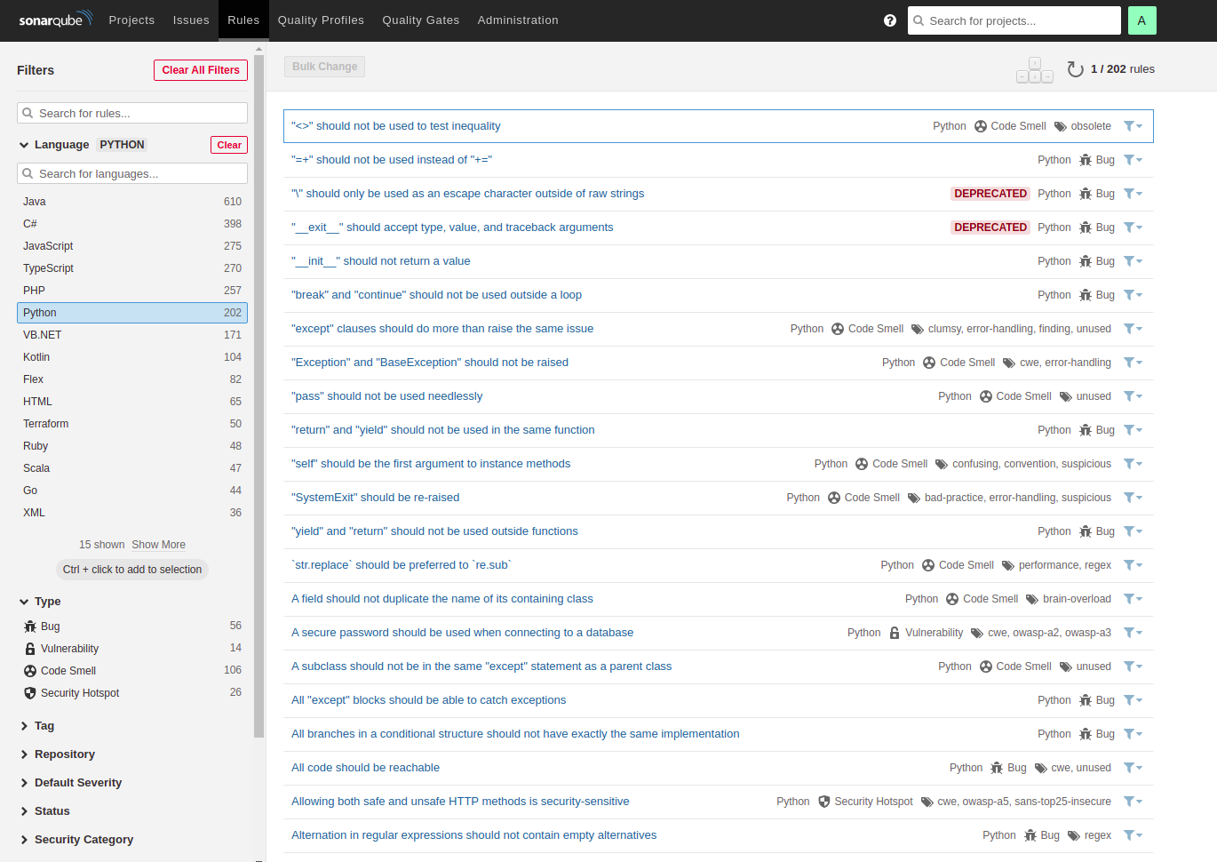
Examples (Coding Rules)

Slide 8
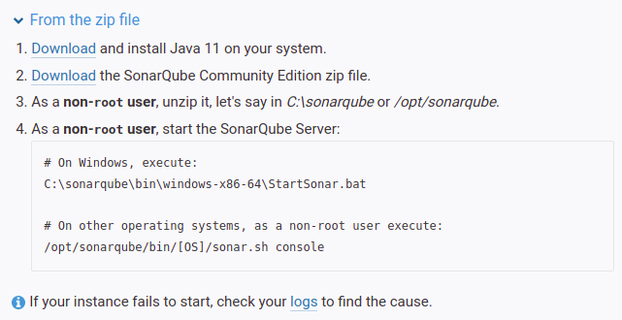
Sonarquobe Installation
https://docs.sonarqube.org/latest/setup/get-started-2-minutes/

Slide 9
Sonaquobe Extensions on IDEs
Some extensions could be installed in the IDEs to continuously give feedback to the developer
Example: Sonarlint

Slide 10
Automated Code Review
We can integrate sonarquobe with github so sonarquobe can review any new pull requests given the coding rules.

Slide 11
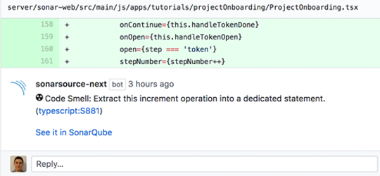
Example

Slide 12
Questions

